Slide 1
Chapter 7
Multi processes control
Notes:
・You exercise the process control and multi processes control using the inter process communication in this chapter.

Slide 2
7.7 Multi processes control
7.7.1 Practice exercise1
Multi processes access to shared memory at the same time
Make the program that the value of the memory is correct even if it accesses the shared memory from multi processes at the same time.
Make the program using the process control and the inter process communication.
Make two programs by composing the chart below.
Shared memory
Program１
operation
process ‘１’
operation
process ‘n’
Program２
input receipt
process ‘１’
input receipt
process ‘n’

Slide 3
Figure related to process
shmemVal
opeProc
message queue
inputReceipt Proc(child)
pipe
inputReceipt Proc(parent)
Notes:
Process function overview
・inputReceiptProc(parent)
inputReceiptProc(parent) waits for the key input after the creating child process, and sends the input data to the child process.
+ inputReceiptProc(parent) creates the child process.
+ inputReceiptProc(parent) waits for the key input data(integer value).
+ When the key is input, inputReceiptProc(parent) sends the input value to inputReceiptProc(child) with the pipe.
・inputReceiptProc(child)
inputReceiptProc(child) sends the key input value to opeProc, and receives the processing result of opeProc.
+ inputReceiptProc(child) receives the integer value that inputReceiptProc(parent) sends with the pipe.
+ inputReceiptProc(child) sends the received integer value to opeProc by the message queue.
+ inputReceiptProc(child) receives the processing result of opeProc by the message queue.
・opeProc
opeProc adds the value of the shared memory and the key input value, and writes the calculation result in the shared memory.
+ opeProc receives the integer value that inputReceiptProc(child) sends by the message queue.
+ opeProc reads and writes systemVal according to the request.
・shmemVal
+ shmemVal stores the integer value(int). (Initial value is 0.)

Slide 4
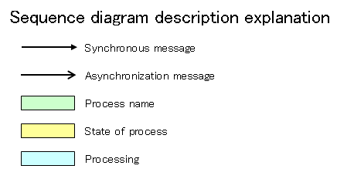
Show the processing sequence from next page.

Slide 5
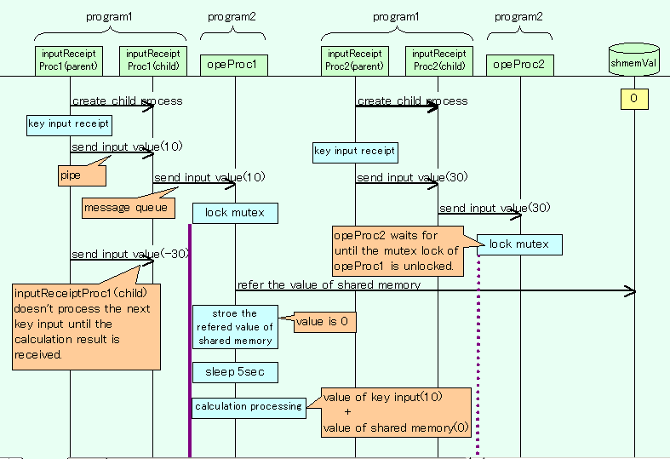
Processing sequence １／２
Notes:
Program１(inputReceiptProc) processing flow
①Program1 creates one child process.
②The parent process accepts the input of the integer value from the console.
③The parent process sends the input value to the child process with the pipe.
④The child process receives the value that the parent process sent with the pipe.
⑤The child process sends the received value to program2 by the message queue.
⑥The child process receives the message sent after program2 finishes processing by the message queue.
Program1 repeats the above ②～⑥.
Program２(opeProc) processing flow
①Program2 receives the message that program1 sent by the message queue.
②To access the shared memory, program2 locks the mutex.
③Program2 refers the value of the shared memory and stores it.
④Program2 sleeps for 5 seconds.
⑤Program2 adds the value received by ① and the value stored by ③.
⑥Program2 writes the calculation result of ⑤ in the shared memory.
⑦Program2 unlock the mutex.
⑧Program2 sends the calculation result to program1 by the message queue.
Program2 repeats the above ①～⑧.

Slide 6
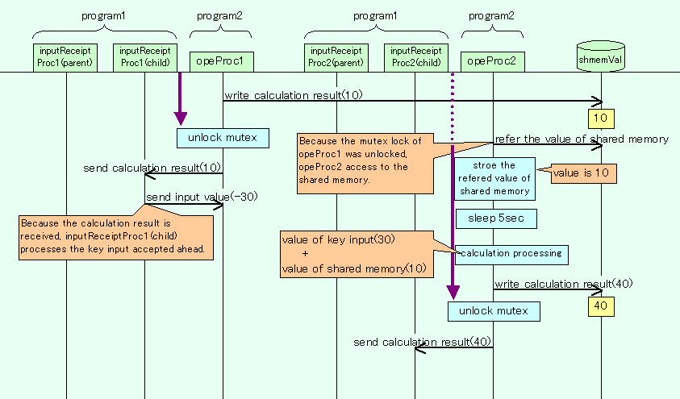
Processing sequence ２／２

Slide 7
7.7.2 Practice exercise2
Multi processes sequential access to shared memory
Make the program that the processes1, 2, 3 repeatedly accesses the shared memory in order.
Make the program using the process control and the inter process communication.
Make two programs by composing the chart below.
Program２
Memory access order
control process
Shared memory
Program１
Memory access
process1
Memory access
process2
Memory access
process3
Notes:
Program overview
・Program1
+ Memory access processes of program1 accesses to the shared memory according to the instruction of memory access order control process of program2.
+ Memory access processes are created from the parent process as children processes.
・Program2
+ Memory access order control process of program2 controls order accessed to the shared memory by memory access processes of program1.

Slide 8
Figure related to process
shmemVal
accOrderCtrl
memAccProc1
memAccProc2
memAccProc3
memAccProcGen
Notes:
Process function overview
・shmemVal
+ shmemVal stores two integer value(X, Y). Initialize value is 0.
memAccProc uses value of X and Y for the calculation processing.
・memAccProcGen
memAccProcGen creates children processes that access the shared memory.
+ memAccProcGen creates 3 children processes (memAccProc1～3).
+ After creating children processes, memAccProcGen do nothing.
・memAccProc
memAccProc accesses to shmemVal according to the control of accOrderCtrl.
memAccProc calculates using the value of referred shmemVal, and memAccProc update shmemVal in a fixed value.
+ memAccProc sends the memory access inquiry to accOrderCtrl by the message queue.
+ memAccProc receives signal from accOrderCtrl, and do the following processing.
memAccProc locks the semaphore, before processing and unlocks semaphore, after processing.
- memAccProc1 writes “X=10, Y=0” to shmemVal.
- memAccProc2 calculates (100 / X) referring to the value of shmemVal.
And memAccProc writes “X=0, Y=10” to shmemVal.
- memAccProc3 calculates (10000 / Y) referring to the value of shmemVal.
And memAccProc writes “X=0, Y=0” to shmemVal.
+ memAccProc sends the processing finished message to accOrderCtrl by the message queue.
・accOrderCtrl
accOrderCtrl controls order that memAccProc accesses to the shared memory.
+ accOrderCtrl receives the memory access inquiry that memAccProc sends by the message queue.
+ accOrderCtrl sends signal(SIGUSR1) when inquired from the process that accesses to the shared memory next.
+ accOrderCtrl receives the processing finished message which memAccProc sends by the message queue.

Slide 9
Show the processing sequence from next page.

Slide 10
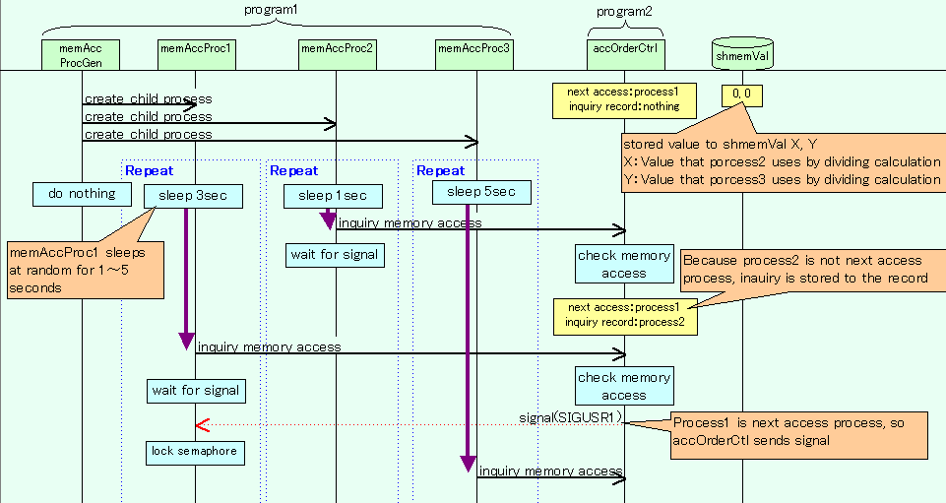
Processing sequence １／４
Notes:
Program１(memAccProcGen) processing flow
①memAccProcGen creates 3 children processes (memAccProc1～3).
②After ①, memAccProcGen do noting.
Program１(memAccProc1) processing flow
①memAccProc1 sleeps at random for 1～5 seconds, after it is generated by memAccProcGen.
②After sleeping, memAccProc1 sends the memory access inquiry to accOrderCtrl by the message queue.
③memAccProc1 wait for receiving signal(SIGUSR1).
④After sending signal, memAccProc1 locks the semaphore.
⑤memAccProc1 writes “X=10, Y=0” to shmemVal.
⑥memAccProc1 unlocks the semaphore.
⑦memAccProc1 sends the processing finished message to accOrderCtrl by the message queue.
Program1(memAccProc1) repeats the above ①～⑦.
Program１(memAccProc2) processing flow
The processing of memAccProc2 is same as memAccProc1 except ⑤.
⑤memAccProc2 calculates (100 / X) referring to the value of shmemVal.
And memAccProc writes “X=0, Y=10” to shmemVal.
Program１(memAccProc3) processing flow
The processing of memAccProc3 is same as memAccProc1 except ⑤.
⑤memAccProc3 calculates (10000 / Y) referring to the value of shmemVal.
And memAccProc writes “X=0, Y=0” to shmemVal.

Slide 11
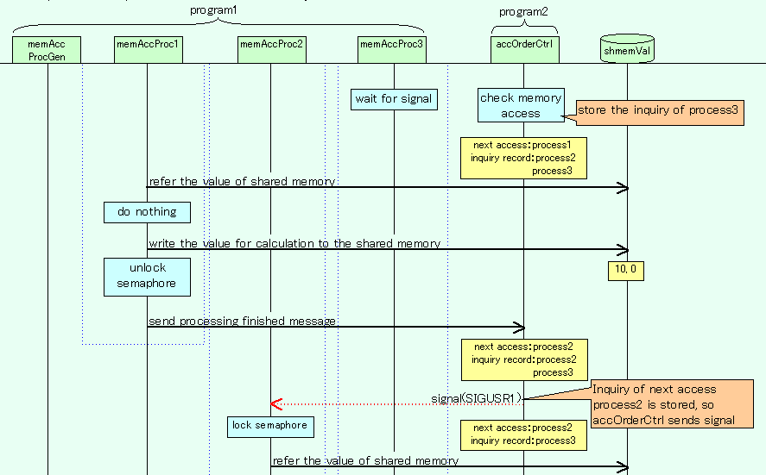
Processing sequence ２／４
Notes:
Program２(accOrderCtrl) processing flow
①accOrderCtrl waits for the memory access inquiry from memAccProc by the message queue.
②After the memory access inquiry, accOrderCtrl checks whether the process may access the memory next.
+ When it is not a process that may access, accOrderCtrl stores the inquiry of the process in the record, and return to processing ①.
+ When it is a process that may access, accOrderCtrl sends the signal to the process.
③accOrderCtrl waits for the processing finished message by the message queue from the process which sends the signal.
④After receiving the processing finished message, accOrderCtrl checks whether to store the inquiry from the process accessing the memory in the record.
+ When the record is not stored, accOrderCtrl returns to processing ①.
+ When the record is stored, accOrderCtrl sends signal to the process, and returns to processing ③.
Program2 repeats the above ①～ ④.

Slide 12
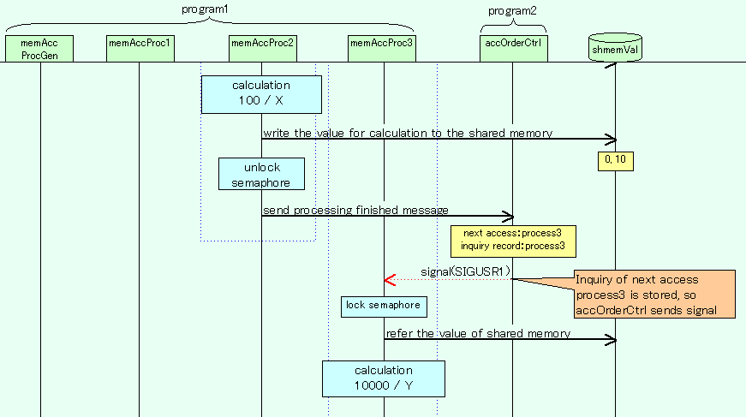
Processing sequence ３／４

Slide 13
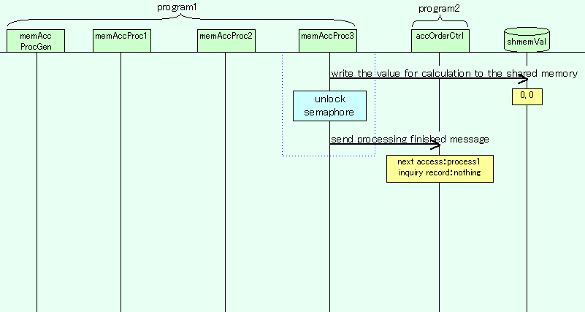
Processing sequence ４／４

